Slide 1
PROGRAMMING SUPPORT OF GOOGLE APP ENGINE
Programming the Google App Engine
Google File System (GFS)
BigTable, Google’s NOSQL System
Chubby, Google’s Distributed Lock Service

Slide 2
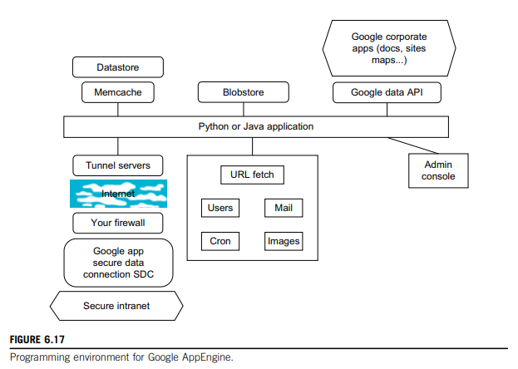
PROGRAMMING THE GOOGLE APP ENGINE
Figure 6.17 summarizes some key features of GAE programming model for two supported languages: Java and Python.

Slide 3
Client environment (that includes an Eclipse plug-in for Java) - allows you to debug your GAE on your local machine.
Google Web Toolkit (GWT) - available for Java web application developers.
Developers can use this, or any other language using a JVM based interpreter or compiler, such as JavaScript or Ruby.
Python - used with frameworks such as Django and CherryPy
Google - also provides a built in webapp Python environment.
Java offers Java Data Object (JDO) & Java Persistence API (JPA) interfaces.
Python has a SQL-like query language called GQL (Graph Query Language).

Slide 4
There are several powerful constructs for storing and accessing data.
The Data store - is a NOSQL (Not Only SQL) data management system - for entities that can be (at most) 1 MB in size
- and labeled by a set of schema-less properties.
The data store is strongly consistent and uses optimistic concurrency control.
Your application can execute multiple data store operations in a single transaction which either all succeed or all fail together.
The data store implements transactions across its distributed network using “entity groups.”
A transaction manipulates entities within a single group.
Entities of the same group are stored together for efficient execution of transactions.
Your GAE application can assign entities to groups when the entities are created.

Slide 5
Performance of the data store can be enhanced by in-memory caching using - memcache, which can also be used independently of the data store.
blobstore - suitable for large files as its size limit is 2 GB.
There are several mechanisms for incorporating external resources.
SDC Secure Data Connection - tunnel through Internet and link your intranet to an external GAE application.
URL Fetch - provides the ability for applications to fetch resources & communicate with other hosts over the Internet using HTTP and HTTPS requests.
Specialized mail mechanism to send e-mail from your GAE application.

Slide 6
There are dozens of Google “corporate” facilities including maps, sites, groups, calendar, docs, and YouTube, among others.
  An application can use Google Accounts for user authentication.
GAE provides the ability to manipulate image data using a dedicated Images service which can resize, rotate, flip, crop, and enhance images.
Your application can perform these tasks on a schedule that you configure, such as on a daily or hourly basis using “cron jobs,” handled by the Cron service.
A GAE application is configured to consume resources up to certain limits or quotas.
With quotas, GAE ensures that your application won’t exceed your budget, and that other applications running on GAE won’t impact the performance of your app.

Slide 7
GOOGLE FILE SYSTEM (GFS)
GFS - fundamental storage service for Google’s search engine.
Size of web data that was crawled and saved was quite substantial - Google needed a distributed file system to redundantly store massive amounts of data on cheap and unreliable computers.
Traditional distributed file systems - cannot provide such functions & hold such large amounts of data.
Several assumptions concerning GFS:
  characteristic of the cloud computing hardware infrastructure - high component failure rate - as servers composed of inexpensive commodity components.
  file size in GFS - huge files, each 100 MB or larger, with files that are multiple GB in size quite common.
Thus, Google has chosen its file data block size to be 64 MB instead of the 4 KB in typical traditional file systems.

Slide 8
I/O pattern-
Files - written once & write operations are often the appending data blocks to the end of files.
There will be a lot of large streaming reads and only a little random access. As for large streaming reads, highly sustained throughput is much more important than low latency.
Reliability is achieved by using replications (i.e., each chunk or data block of a file is replicated across more than three chunk servers).
A single master coordinates access as well as keeps the metadata.
There is no data cache in GFS as large streaming reads and writes represent neither time nor space locality.
GFS provides a similar, but not identical, POSIX file system accessing interface.
The distinct difference is that the application can even see the physical location of file blocks. Such a scheme can improve the upper-layer applications.

Slide 9
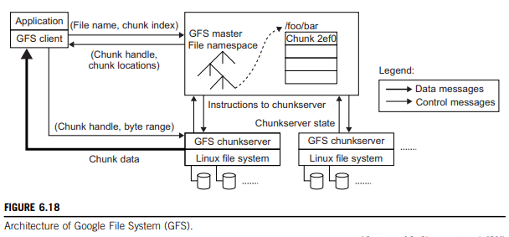
Figure 6.18 shows the GFS architecture. There is a single master in the whole cluster. Other nodes act as the chunk servers for storing data, while the single master stores the metadata.
File system namespace & locking facilities - managed by master.
The master periodically communicates with the chunk servers to collect management information as well as give instructions to the chunk servers to do work such as load balancing or fail recovery.

Slide 10
With single master, many complicated distributed algorithms can be avoided and the design of the system can be simplified.
However, a potential weakness - single GFS master could be the performance bottleneck & single point of failure.
To mitigate this, Google uses a shadow master to replicate all the data on master & design guarantees that all the data operations are performed directly between the client & chunk server.
Figure 6.19 shows the data mutation (write, append operations) in GFS.
Data blocks must be created for all replicas.
The goal is to minimize involvement of the master.

Slide 11
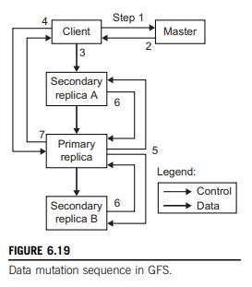
The mutation takes the following steps:
1. client – master: which chunk server holds the current lease for the chunk and the locations of other replicas. If no one has a lease, the master grants one to a replica it chooses (not shown).
2. master replies with the identity of primary & locations of other (secondary) replicas. The client caches this data for future mutations. It needs to contact the master again only when the primary becomes unreachable or replies that it no longer holds a lease.
3. client pushes data to all replicas. Each chunk server will store the data in an internal LRU buffer cache until the data is used or aged out.
4. Once all replicas acknowledges data, client sends a write request to primary.
The request identifies the data pushed earlier to all the replicas.
The primary assigns consecutive serial numbers to all the mutations it receives, possibly from multiple clients, which provides the necessary serialization.
It applies the mutation to its own local state in serial order.

Slide 12
5. The primary forwards the write request to all secondary replicas.
Each secondary replica applies mutations in the same serial number order assigned by the primary.
6. The secondaries all reply to the primary indicating that they have completed the operation.
7. The primary replies to the client.
Any errors encountered at any replicas are reported to the client. In case of errors, the write corrects at the primary and an arbitrary subset of the secondary replicas.
The shadow master handles the failure of the GFS master.
For data integrity, GFS makes checksums on every 64 KB block in each chunk.
With the previously discussed design and implementation, GFS can achieve the goals of high availability (HA), high performance, and large scale.

Slide 13
BIGTABLE, GOOGLE’S NOSQL SYSTEM
BigTable - designed to provide a service for storing & retrieving structured and semistructured data.
BigTable applications - storage of web pages, per-user data & geographic locations.
Here we use web pages to represent URLs & their associated data, such as contents, crawled metadata, links, anchors, and page rank values.
Per-user data has information for a specific user, includes such data as user preference settings, recent queries/search results, and the user’s e-mails.
Geographic locations are used in Google Earth software. Geographic locations include physical entities (shops, restaurants, etc.), roads, satellite image data, and user annotations.
The scale of such data is incredibly large. There will be billions of URLs and also user scale, geographic data are also huge.

Slide 14
It is not possible to solve such a large scale of structured or semistructured data using a commercial database system.
This is one reason to rebuild the data management system; the resultant system can be applied across many projects for a low incremental cost.
Other motivation - is performance.
Low-level storage optimizations help increase performance significantly.
Design and implementation of BigTable system has the following goals:
Applications want asynchronous processes to be continuously updating different pieces of data & want access to the most current data at all times.
Database needs to support very high read/write rates , scale might be millions of operations per second.
Also, database needs to support efficient scans over all or interesting subsets of data, as well as efficient joins of large one-to-one and one-to-many data sets.
Application may need to examine data changes over time (e.g., contents of a web page over multiple crawls).

Slide 15
Thus, BigTable can be viewed as a distributed multilevel map.
It provides a fault-tolerant & persistent database as in a storage service.
The BigTable system is scalable, which means the system has thousands of servers, terabytes of in-memory data, petabytes of disk-based data, millions of reads/writes per second, and efficient scans.
Also, BigTable is a self-managing system (i.e., servers can be added/removed dynamically and it features automatic load balancing).
BigTable is used in many projects, including Google Search, Orkut, and Google Maps/Google Earth, among others.
The BigTable system is built on top of an existing Google cloud infrastructure. BigTable uses the following building blocks:
1. GFS: stores persistent state
2. Scheduler: schedules jobs involved in BigTable serving
3. Lock service: master election, location bootstrapping
4. MapReduce: often used to read/write BigTable data

